Slide 1
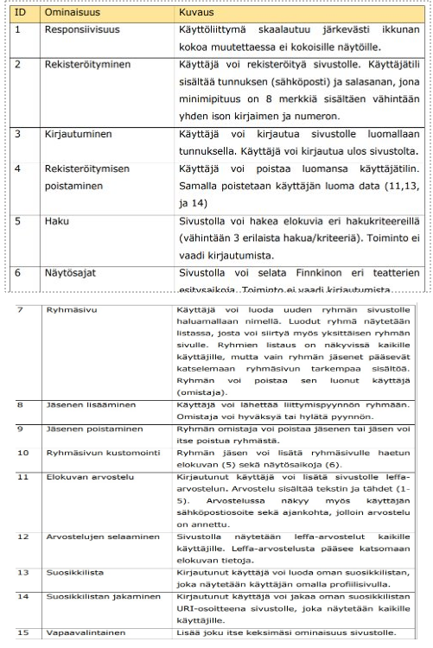
Functionalities
Group 10

Slide 2
Responsiveness
User interface scales sensibly when resizing the window.

Slide 3
Registration
User can registrate.
User account contains email and password.
Password must contain at least one number and one capital letter and is at least 8 characters long.

Slide 4
Login
User can login and logout using the account they have made.

Slide 5
Deregistration
User can delete the account they have made. Deleting the account also deletes all the data.

Slide 6
Search
User can search for movies and series using different criteria.
The criteria are: Search movies by actor, search movies by director, and search series by title.

Slide 7
Screening times
The site shows the movies that are currently playing in cinemas.
The movies can be seen in movie carousel.

Slide 8
Group page
User can create new group and name it however they want.
Everyone can see all groups on the list. You have to be part of the group to open the wanted page.
Group can be deleted by the owner of the group. They can do it from their user page.

Slide 9
Adding members
Anyone who has logged in can request to join to group.
The "request to join" –button is next to the group name in the list.
Owner of the group can accept or decline the request from the group page.

Slide 10
Removing members
Owner of the group can remove member from the group.
Member of the group can leave the group.

Slide 11
Group page customization
Member of the group can add movie to group favourite movies.

Slide 12
Movie review
User can make movie review.
The review includes text and stars (from 1 to 5).
You can see who made the review and when the review was made by clicking the movie.

Slide 13
Browsing reviews
Everyone can see the movie reviews.

Slide 14
Favourite list
Logged in user can make list of favourite movies which can be seen in their user page.

Slide 15
Sharing favourite list
Logged in user can share their favourite list as URL.

Slide 16
Optional
User can chat with others in the group page.
User can reserve a seat from a cinema.

